Slide 1
Priority of operations with positive and negative integers, decimals and fractions
Arithmetic procedures with fractions

Slide 2
how to use Oak lessons

Slide 3
I can calculate using priority of operations, including brackets, powers, exponents and reciprocals with positive and negative integers, decimals and fractions.

Slide 4
The additive inverse of a number is a number that, when added to the original number, gives the sum of 0.
Example
8 is the additive inverse of (-8)
Example
(-4.5) is the additive inverse of 4.5
An operation is commutative if the values it is operating on can be written in either order without changing the calculation.
Example
(-3) + 4 + 10 = 10 + (-3) + 4

Slide 5

Priority of operations with positive and negative integers, decimals and fractions
Reviewing priority of operations
Powers and roots of fractions
Calculating efficiently

Slide 6

Reviewing priority of operations
The priority of operations is important as it ensures that everyone can understand and approach a mathematical problem the same way.
This applies to positive and negative integers, fractions and decimals.
( …. )
⬚
⬚
⬚
× ÷
+ −

Slide 7
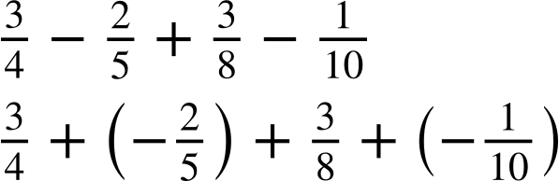
Reviewing priority of operations
When using the priority of operations, a preferred method for the row of addition and subtraction, is to simply use addition with the additive inverses.
Example
( …. )
⬚
⬚
⬚
× ÷
+ −

Slide 8
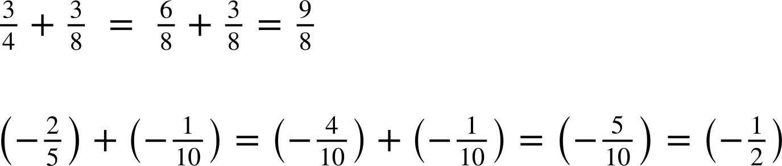
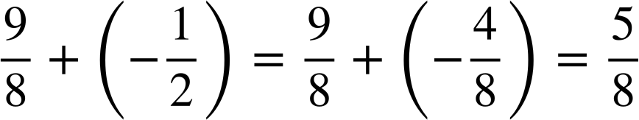
Reviewing priority of operations
When using the priority of operations, a preferred method for the row of addition and subtraction, is to simply use addition with the additive inverses.
Summing the positives
Summing the negatives
( …. )
⬚
⬚
⬚
× ÷
+ −

Slide 9
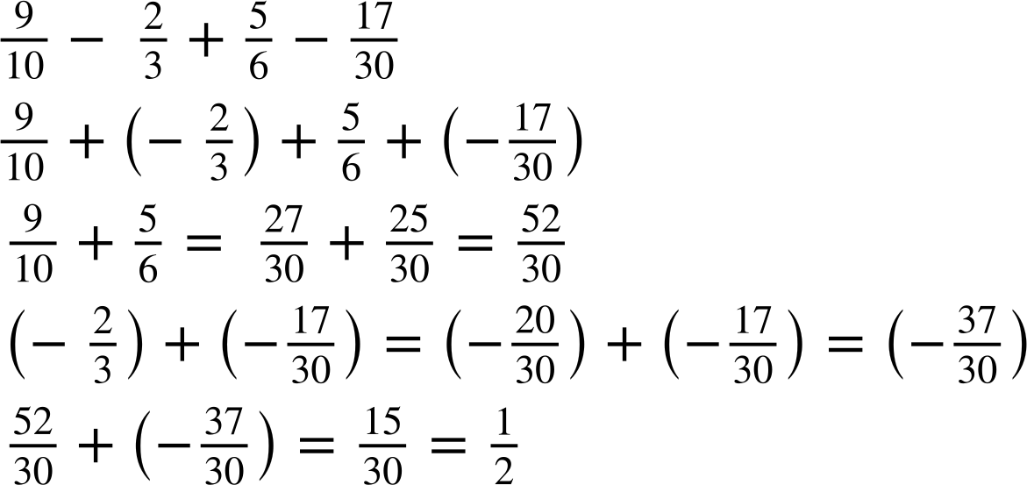
Reviewing priority of operations
Work out the following question, giving your answer in its simplest form.
Summing the positives
Summing the negatives

Slide 10
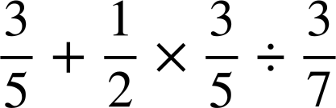
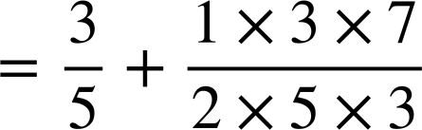
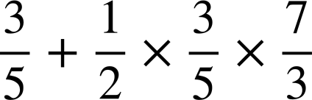
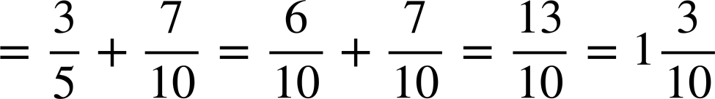
Reviewing priority of operations
When using the priority of operations, the row with multiplication and division can be done in any order.
You now know that division can be written as multiplication by the reciprocal.
For example,
Multiply by the reciprocal
( …. )
⬚
⬚
⬚
×
÷
Multiplication before addition
−
+

Slide 11
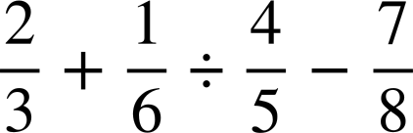
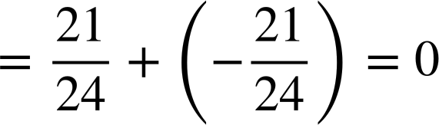
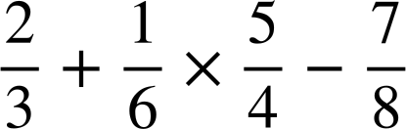
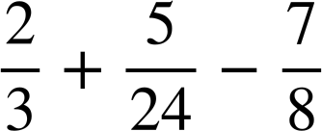
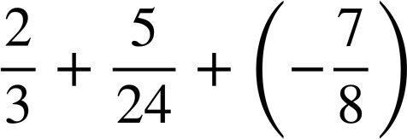
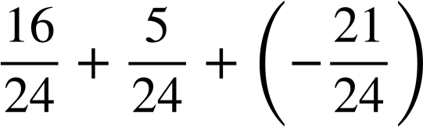
Reviewing priority of operations
Calculate:
Multiply by the reciprocal
Multiplication before addition
Use additive inverse
( …. )
⬚
⬚
⬚
÷
×
Common denominator
−
+

Slide 12
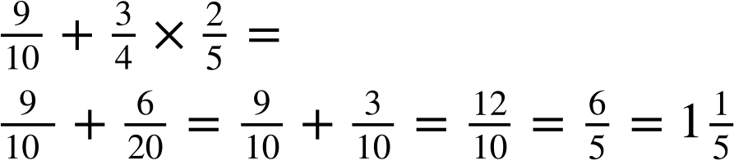
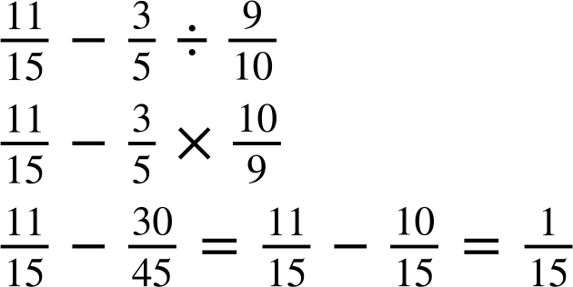
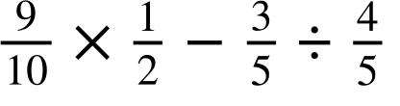
Reviewing priority of operations
Work out the following using the priority of operations, giving your answer in its simplest form where possible.
a)
b)
c)

Slide 13
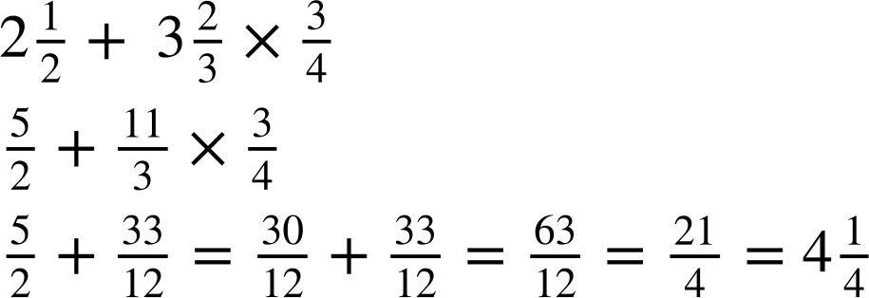
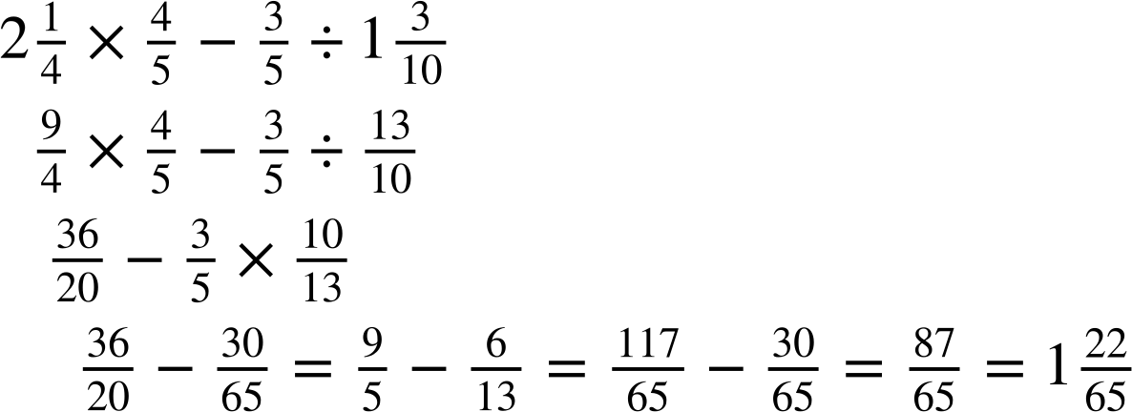
Reviewing priority of operations
2) Work out the following using the priority of operations, giving your answer in its simplest form and a mixed number where possible.
b)

Slide 14
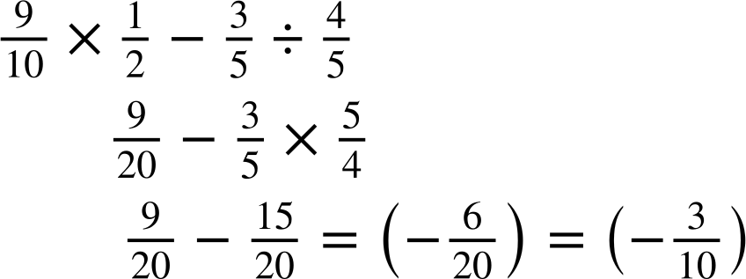
Reviewing priority of operations
Work out the following using the priority of operations, giving your answer in its simplest form where possible.
a)
b)
c)

Slide 15
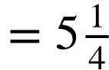
Reviewing priority of operations
2) Work out the following using the priority of operations, giving your answer in its simplest form and a mixed number where possible.
b)

Slide 16
Priority of operations with positive and negative integers, decimals and fractions
Reviewing priority of operations
Powers and roots of fractions
Calculating efficiently

Slide 17
Powers and roots of fractions
The next operations we will be looking at with fractions are roots and powers. This will require previous knowledge of square and cube roots and evaluating using exponents.
Similar to negative numbers, we use brackets or implicit brackets to show the root or exponent of a fraction.
( …. )
⬚
⬚
⬚
× ÷
So let’s begin with notation first.
+ −

Slide 18
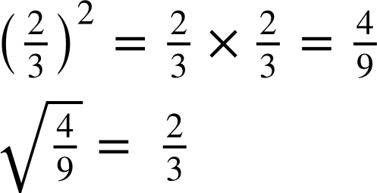
Powers and roots of fractions
For example,
( …. )
⬚
Therefore,
⬚
⬚
× ÷
Implicit brackets
+ −

Slide 19



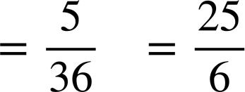
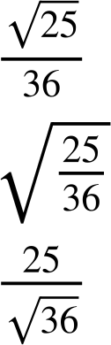

Powers and roots of fractions
Aisha and Laura are given a question.
Work out
The answer is…
The answer is…
Who is correct and can you explain how they made their error?
Neither are correct as the answer is
Aisha thought the question was . Laura thought the question was

Slide 20
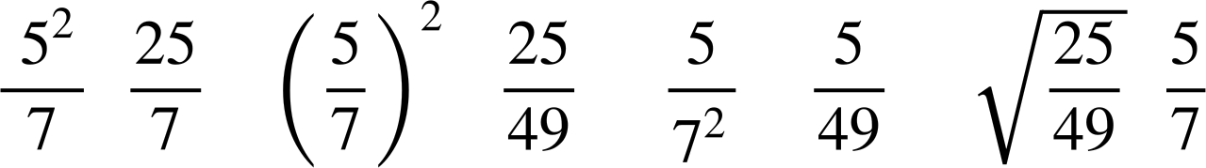
Powers and roots of fractions
Match up the calculation on the top row with the correct answer on the bottom row.

Slide 21
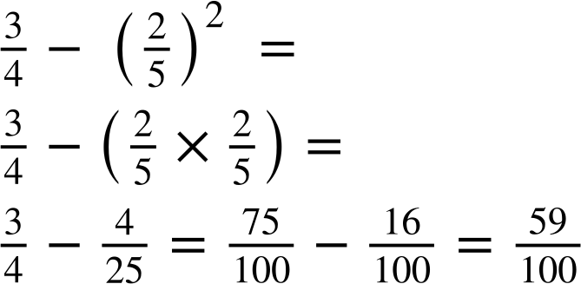
Powers and roots of fractions
It is important to recognise we use our knowledge on square and cube numbers to work out the root or exponent of a fraction.
For example,
( …. )
⬚
⬚
⬚
× ÷
+ −

Slide 22
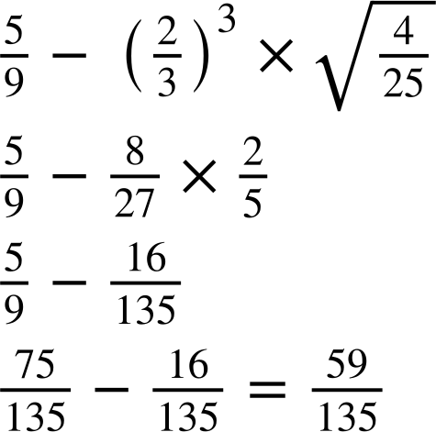

Powers and roots of fractions
Jacob has spilt ink all over his work. Can you figure out what is under each ink blot?

Slide 23
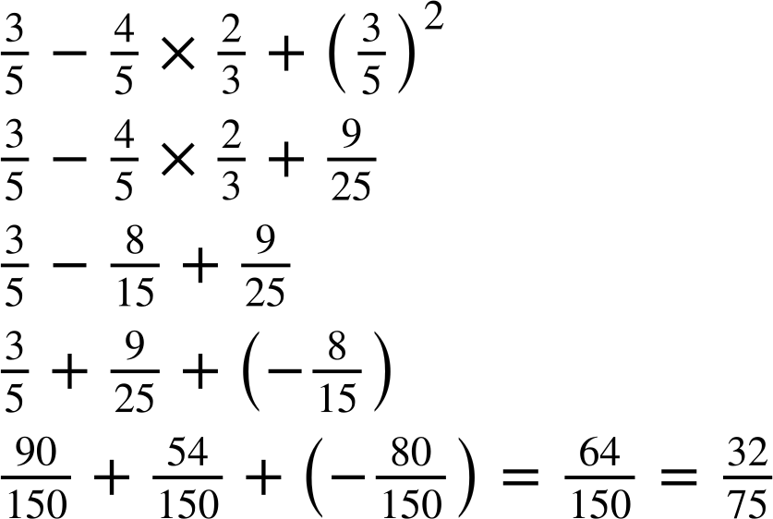
Powers and roots of fractions
Fill in the blanks to complete the calculation.

Slide 24
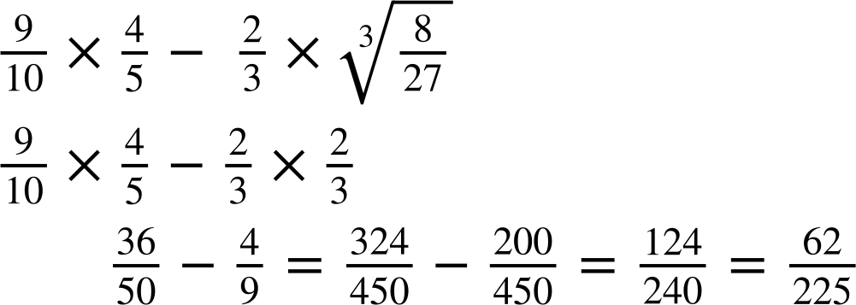
Powers and roots of fractions
2) Work out the answer to the following, giving your answer in its simplest form.

Slide 25
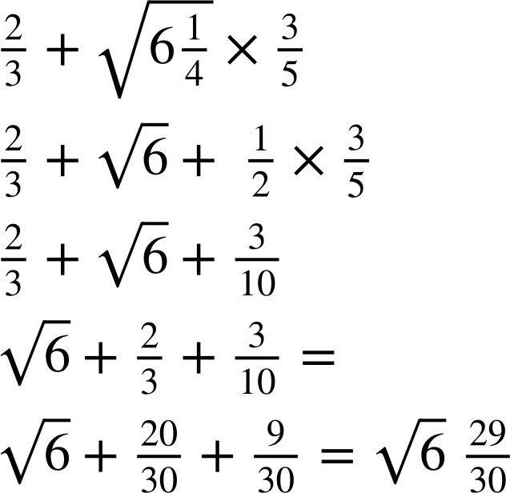
Powers and roots of fractions
3) Lucas has made an error.
Find the error and correctly complete the calculation.

Slide 26
Powers and roots of fractions
Fill in the blanks to complete the calculation

Slide 27
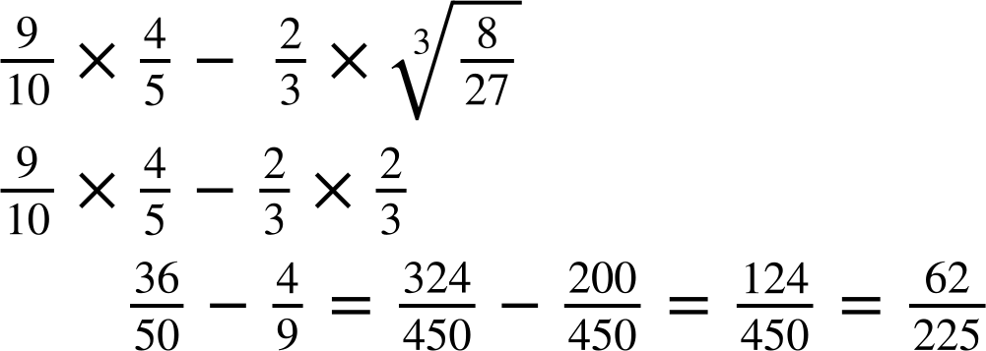
Powers and roots of fractions
2) Work out the answer to the following, giving your answer in its simplest form.

Slide 28
Powers and roots of fractions
3) Lucas has made an error.
Find the error and correctly complete the calculation.
Lucas needed to convert the mixed number into an improper fraction first.

Slide 29
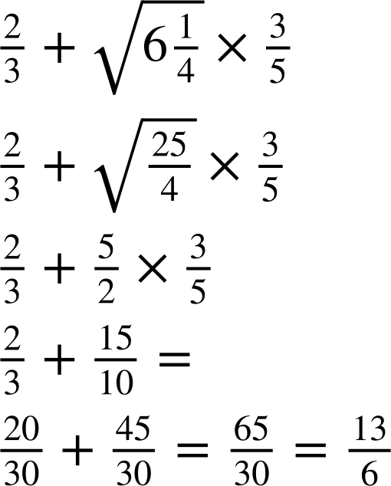
Powers and roots of fractions
Lucas has made an error.
Find the error and correctly complete the calculation.

Slide 30
Priority of operations with positive and negative integers, decimals and fractions
Reviewing priority of operations
Powers and roots of fractions
Calculating efficiently

Slide 31
Calculating efficiently
Now let us use a combination of fractions and decimals with positive and negative integers.
( …. )
⬚
⬚
⬚
× ÷
+ −

Slide 32
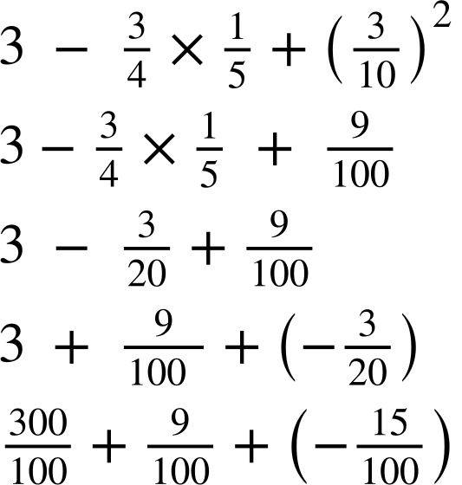
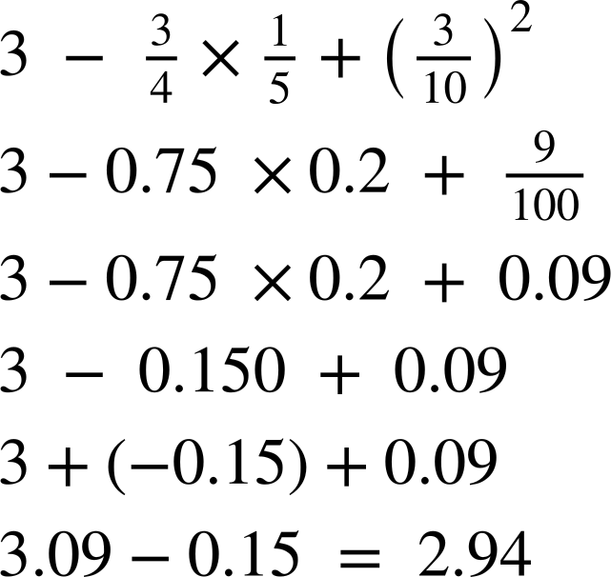

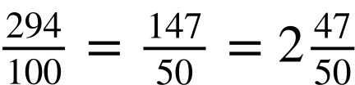
Calculating efficiently
Converting fractions to decimals is an option. For example, Andeep and Sofia both do the same question and both are correct.
Andeep
Sofia

Slide 33
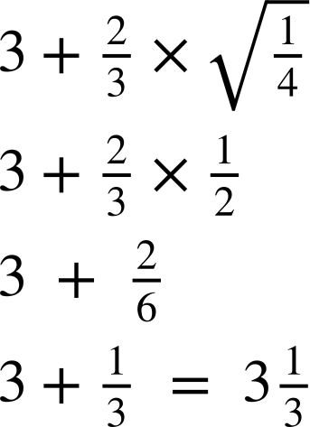
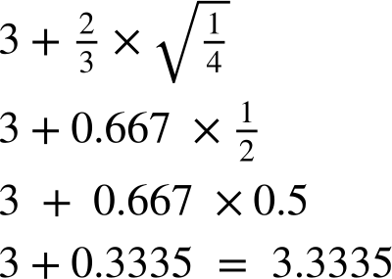
Calculating efficiently
They both do another question, but now someone is less accurate. Who is less accurate and how did it happen?
Andeep
Sofia

Slide 34

Calculating efficiently
The rounding of made Andeep’s answer less accurate than Sofia’s. When using recurring decimals, fractional form ensures greater accuracy.
Andeep
Sofia

Slide 35
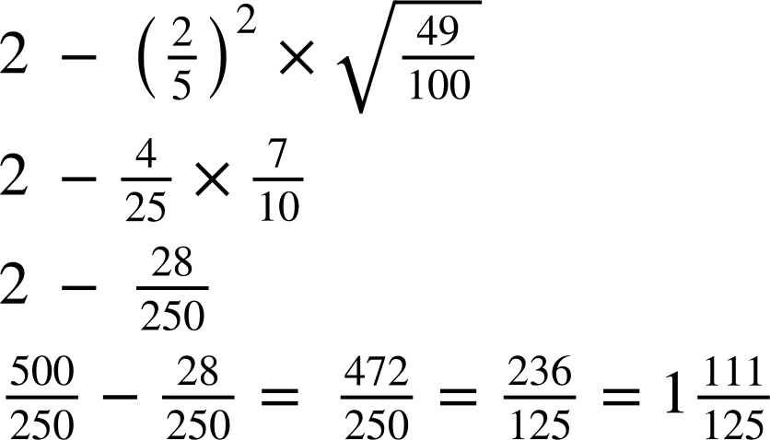
Calculating efficiently
Fill in the blanks to complete the calculation.

Slide 36
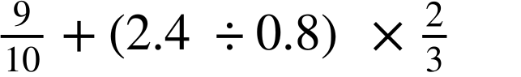
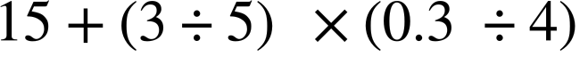
Calculating efficiently
2) Work out the answer to the following, making sure to give your answer as a mixed number in its simplest form.
a)
b)

Slide 37
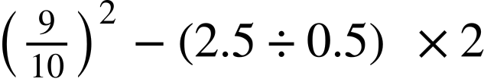
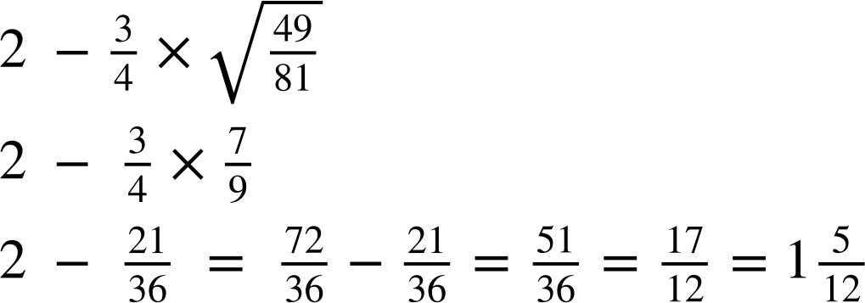
Calculating efficiently
3) Work out the answer to the following, making sure to give your answer as a mixed number in its simplest form.
a)
b)

Slide 38
Calculating efficiently
Fill in the blanks to complete the calculation.

Slide 39
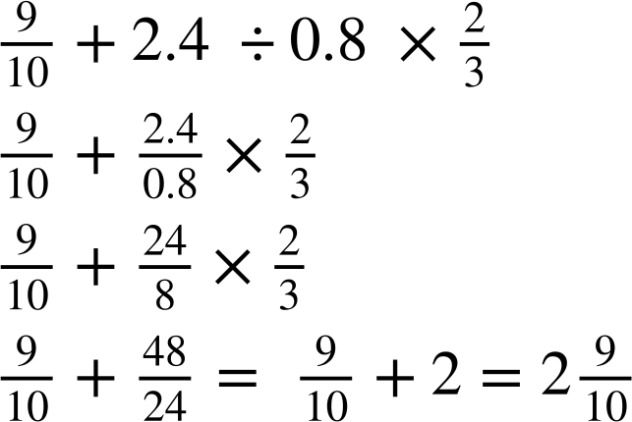
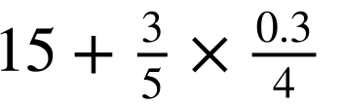
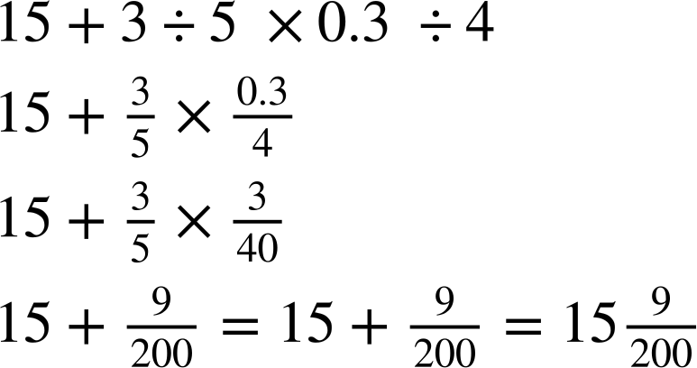
Calculating efficiently
2) Work out the answer to the following, making sure to give your answer as a mixed number in its simplest form.
a)
b)

Slide 40
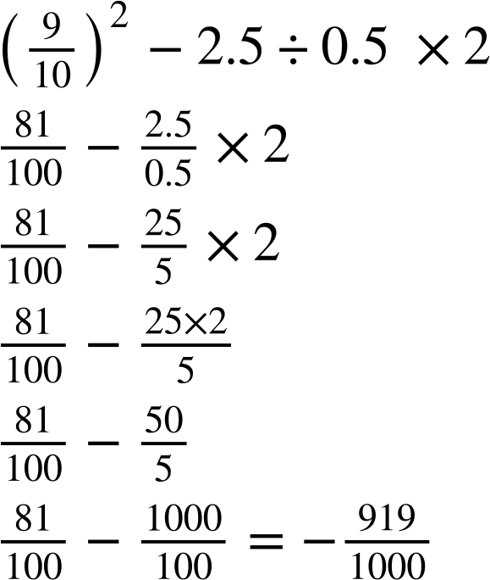
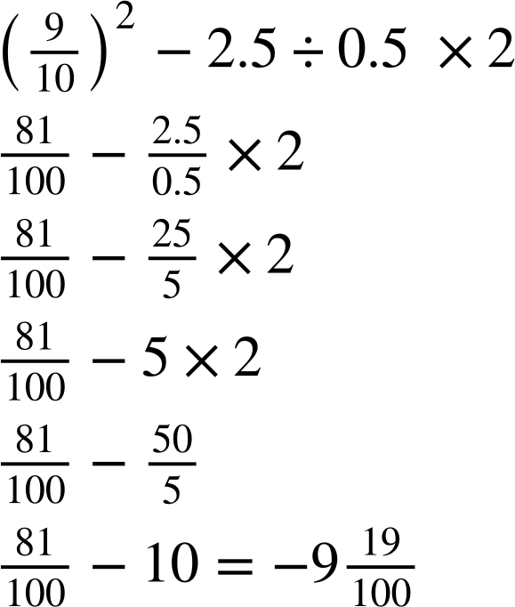
Calculating efficiently
3) Work out the answer to the following, making sure to give your answer as a mixed number in its simplest form.
a)
b)

Slide 41
Priority of operations with positive and negative integers, decimals and fractions
The priority of operations is important as it ensures that everyone can understand and approach a mathematical problem the same way.
This applies to positive and negative integers, fractions and decimals.
( …. )
⬚
⬚
Writing division as a fraction and using the addition of the additive inverses can make calculations easier.
⬚
× ÷
Calculations can be written in decimal form but can lose accuracy when using recurring decimals.
+ −

Slide 42

© Oak National Academy 2023.
Produced in partnership with Mathematics in Education and Industry.
Licensed on the Open Government Licence v3.0, except where otherwise stated. See Oak terms and conditions.

